Slide 1

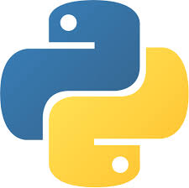
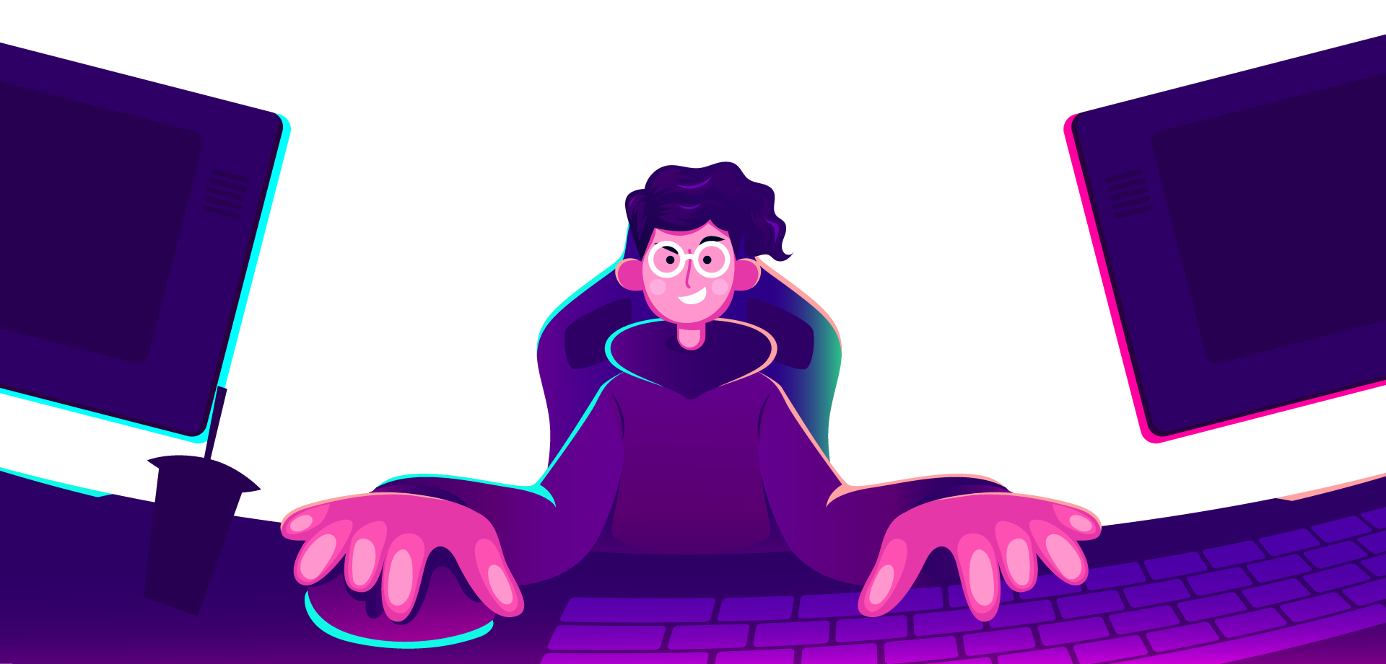
AI Master Class series – Day 3
Introductions to Computer Vision & its Libraries

Slide 2
Announcement
Attendance link will be available around
8:30 PM.

Slide 3
Day-3 Agenda.
01.
02.
03.
Application of Computer Vision
Libraries of Computer vision
Introduction to Computer Vision
04.
05.
Computer Vision examples
Q & A Session
CV & Image processing vs CV
Available libraries and Installing OpenCV
Evolution & applications
Basic OpenCV functions

Slide 4
What is Computer Vision?.
Early experiments in computer vision took place in the 1950s, using some of the first neural networks to detect the edges of an object and to sort simple objects into categories like circles and squares.
Computer vision is an interdisciplinary scientific field that deals with how computers can gain high-level understanding from digital images or videos.

Slide 5
Image Processsing vs Computer vision.
Image processing, an image is "processed", transformations are applied to an input image to get output image.
Computer vision, an image or a video is taken as input, and the goal is to understand the image and its contents which uses image processing algorithms to solve some of its tasks like human brain

Slide 6
Applications.
Evolution.
Object recognition
Face recognition
Autonomous vehicle
Disease detection
Emotion recognition
Agriculture
Satellite image analysis
Robot vision
Search engines
Mobile & camera
Pattern recognition
Image Segmentation
Edge Detection
Watermarking
Steganography
Cryptography
Moving object Detection
Object recognition
Autonomous Vehicle
Satellite image analysis
Medical image analysis
OCR

Slide 7

Practical session

Slide 8
Not all Libraries are supporting Python 3.9

Slide 9
Installing OpenCV
OpenCV: pip install opencv-python
or
Installing it from the source

Slide 10
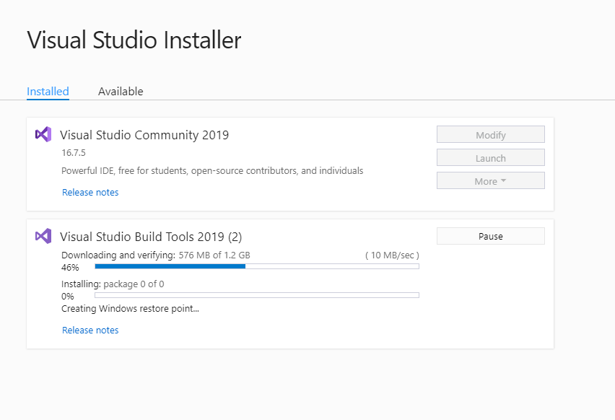
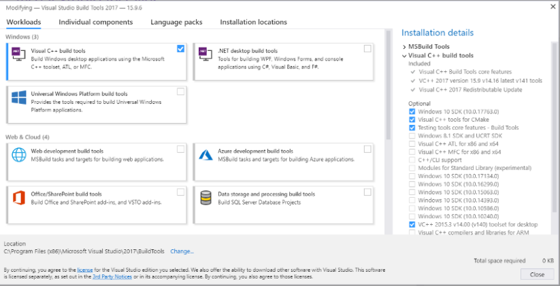
Microsoft C++ Build Tools: https://visualstudio.microsoft.com/visual-cpp-build-tools/
or from
Visual Studio

Slide 11

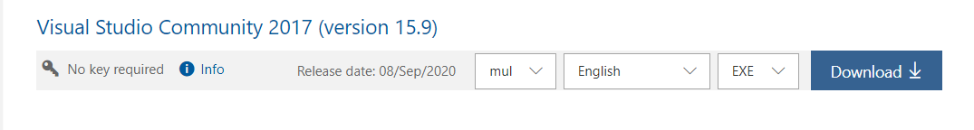
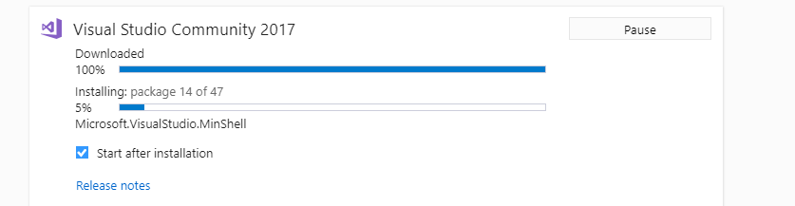
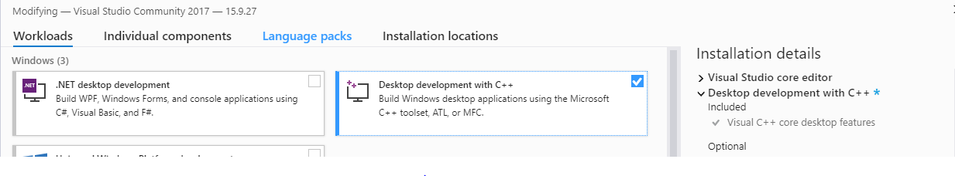
Microsoft Visual studio 2017: https://my.visualstudio.com/Downloads?q=visual%20studio%202017&wt.mc_id=o~msft~vscom~older-downloads

Slide 12
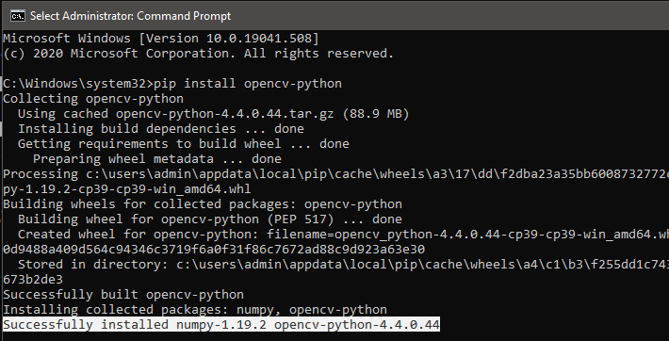
Successfully Installed OpenCV in Python 3.9. But not all library

Slide 13
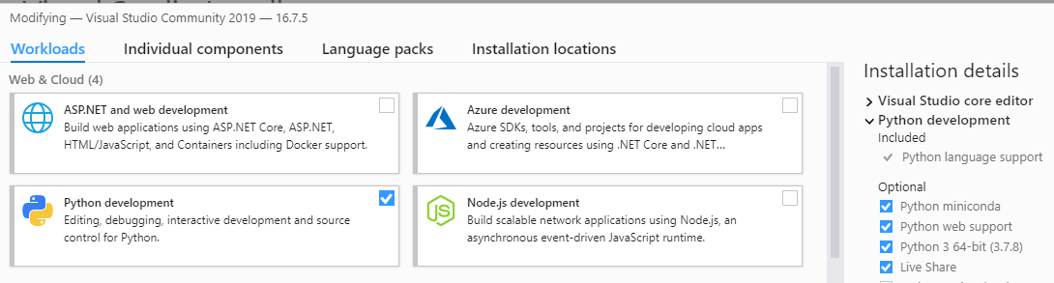
Alternate way of Installing OpenCV & Its libraries without any error
Installing Python from Visual Studio
Or Install stable version of Python

Slide 14

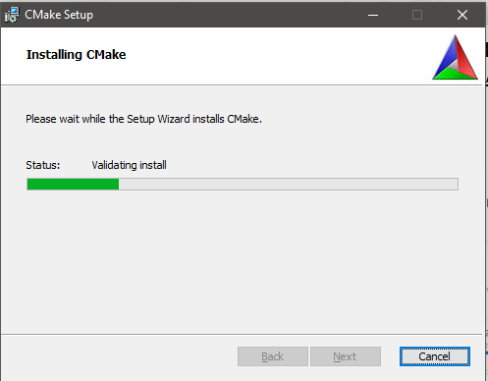
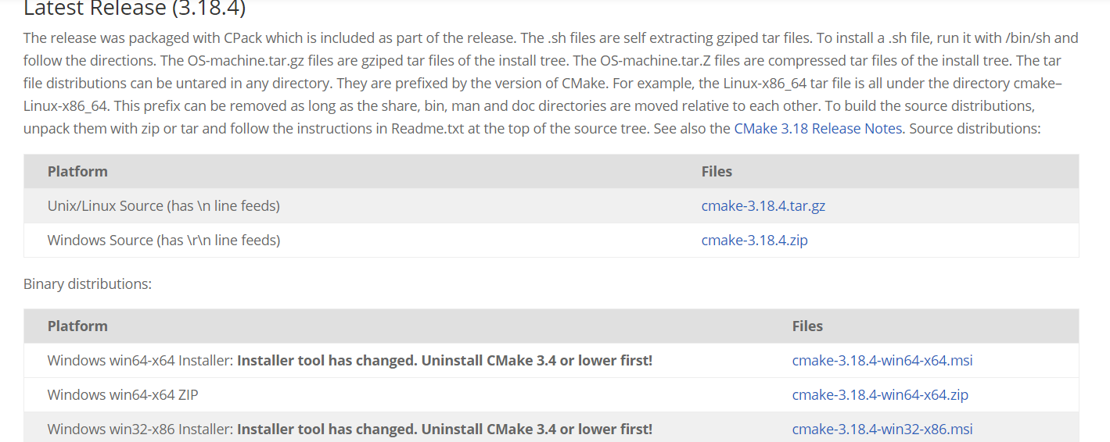
CMAKE: https://cmake.org/download/

Slide 15
Installing OpenCV
OpenCV: pip install opencv-python
or
Installing it from the source

Slide 16
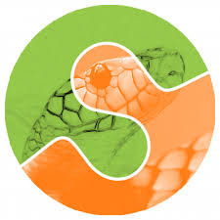
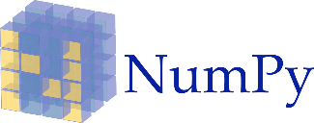
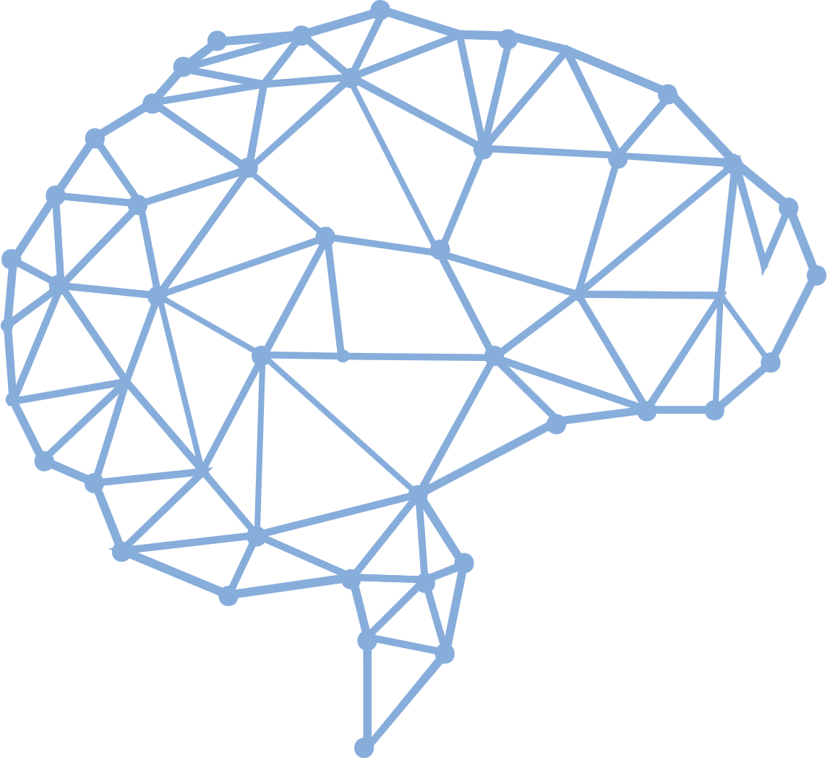
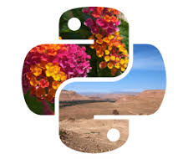



Libraries.
Numerical Python
Scikit-image
NumPy is a library for the Python programming language, adding support for large, multi-dimensional arrays and matrices, along with a large collection of high-level mathematical functions to operate on these arrays.
It includes algorithms for segmentation, geometric transformations, color space manipulation, analysis, filtering, morphology, feature detection, and more.
Scientific Python
PIL
SciPy contains modules for optimization, linear algebra, integration, interpolation, special functions, FFT, signal and image processing
It adds support for opening, manipulating, and saving many different image file formats.
Mahotas
Open CV
Mahotas is a includes many algorithms implemented in C++ for speed while operating in numpy arrays and with a very clean Python interface.
OpenCV is a library of programming functions mainly aimed at real-time computer vision.

Slide 17
Installing Libraries
Wheel: pip install wheel
Matplotlib: pip install matplotlib
Imutils: pip install imutils
Scipy: pip install scipy

Slide 18
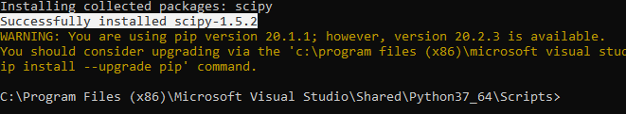
Successfully Installed OpenCVand other libraries in Python 3.7

Slide 19
Basic programs on Computer Vision

Slide 20
Read, Show & Write an Image.
import numpy as np
import cv2
img = cv2.imread(‘sample2.jpg') cv2.imshow(‘show',img)
cv2.imwrite(‘photo.jpg',img)
cv2.waitKey(0)
cv2.destroyAllWindows()

Slide 21
Converting Color Image to Greyscale Image.
import cv2
image = cv2.imread(‘sample1.png')
greyImage = cv2.cvtColor(image, cv2.COLOR_BGR2GRAY)
cv2.imwrite('gray_image.png', greyImage)
cv2.imshow(‘Color_image',image)
cv2.imshow(‘Grey_image', greyImage)
cv2.waitKey(0)
cv2.destroyAllWindows()

Slide 22
Image Properties.
Import cv2
img = cv2.imread(‘sample2.jpg')
print (img.shape) #(342, 548, 3)
print (img.size) #562248
print (img.dtype) #uint8

Slide 23
Q & A session

Slide 24
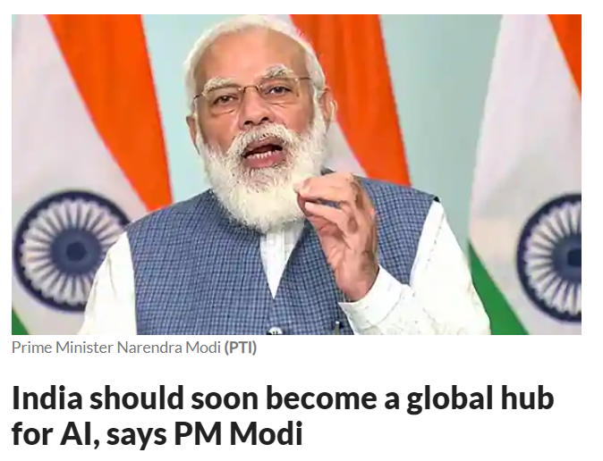
AI News – Day 3. OCT-2020
Speaking at the Responsible AI for Social Empowerment (RAISE) 2020 summit, PM Modi said that while he wants India to become a global hub for AI, it is also a collective responsibility of the nation to protect the world from misuse of AI by non-state actors such as cyber criminals, terrorists, among others.

Slide 25

Thanks!
Tomorrow session
Do you have any questions?
sanjay@pantechmail.com
www.pantechsolutions.net
Moving Object Detection and Tracking using OpenCV

